Slide 1
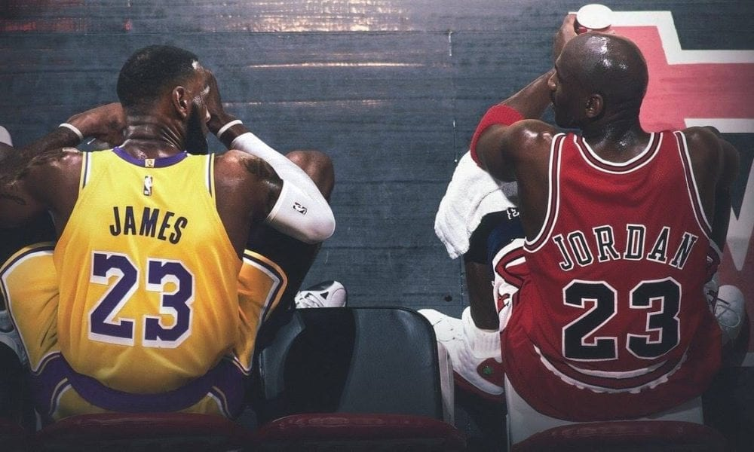
Who’s The Real MVP? MJ vs. Lebron
Capstone Project for Part Time Data Analytics Cohort DA5.
By
Austin Peay

Slide 2
Data Sources
This project will be using data published by Basketball Reference.
Data tools used include:
Excel
Power Bi
Python

Slide 3
Challenges?
Having a large amount of Data.
The Scrapper Package I used in Python grabbed the individual players data by year.
Cleaning became tedious with having 20+ tabs in Excel.

Slide 4
Data Questions?
The Goat? This question has been brewing around ever since Lebron James won his first championship. Is Michael Jordan the greatest of all time or is Lebron James the greatest of all time?
Did teammates affect the individual's performance?

Slide 5
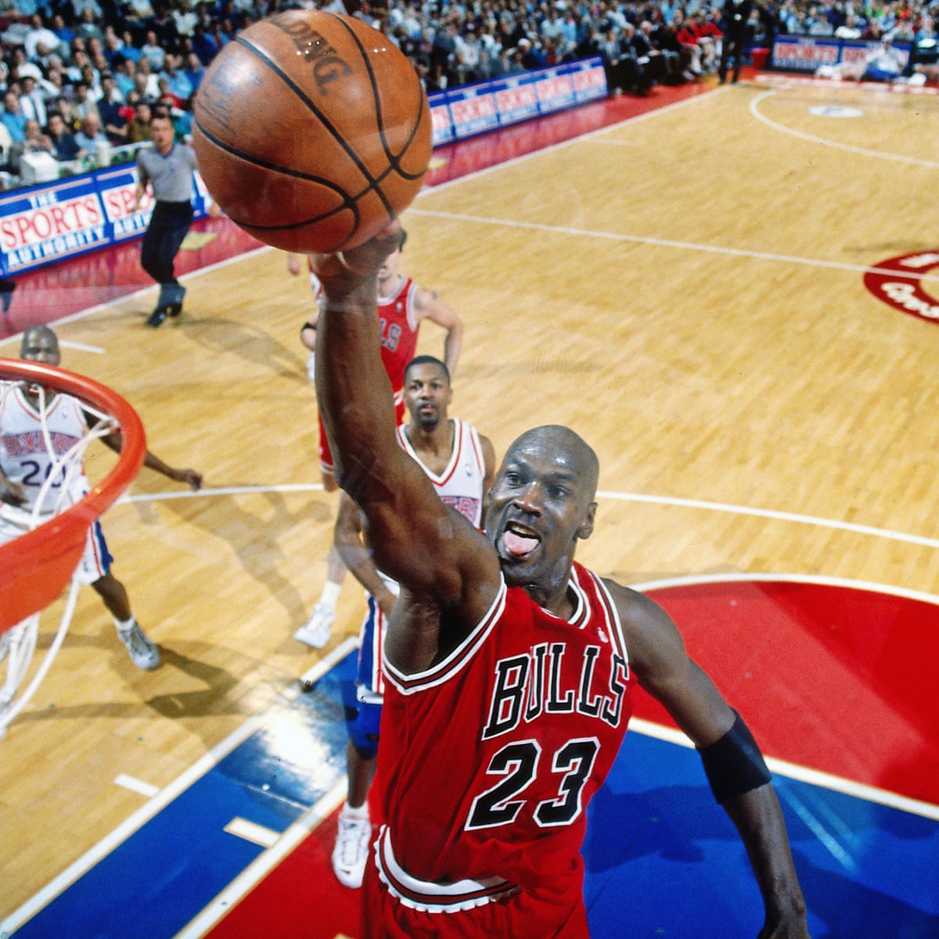
Who is Michael Jordan?
6x NBA Champion and 6x NBA Finals MVP
Having won 3 championships in a row
5x NBA MVP
14x NBA All-Star
2x Olympic gold medal winner

Slide 6
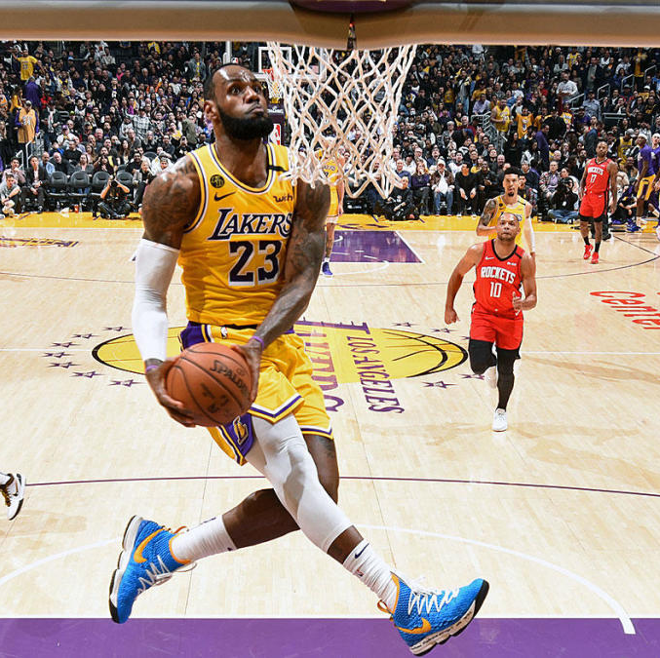
Who is LeBron James?
4x NBA Champion and 4x Finals MVP
4x NBA MVP
17x NBA All-Star
2x Olympic gold medal winner
3x NBA All-Star Game MVP
5x NBA All-Defensive First Team
NBA rookie of the Year

Slide 7
Dashboard
https://app.powerbi.com/groups/me/reports/930cd2e1-5d65-4328-a2c9-d8e3f44bd40f/ReportSectionb7cbee2159a3e0190e65

Slide 8


Acting?

Slide 9
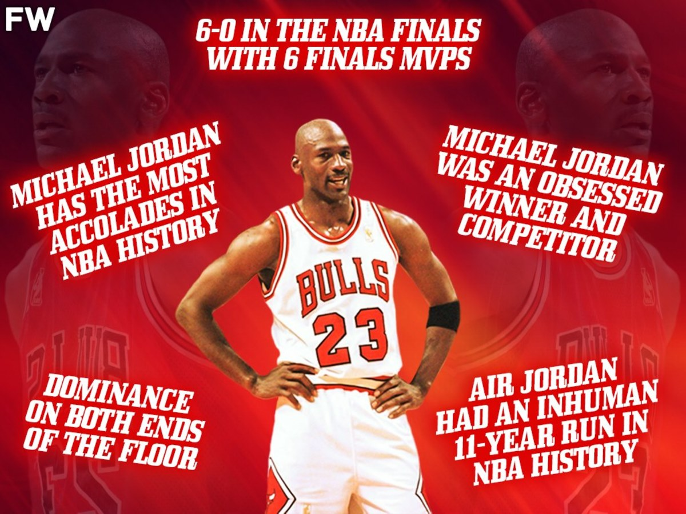
So, Who’s The Goat?

